Slide 1

Landscape Architecture Merit Badge
Troop 344 and 9344
Pemberville, OH

Slide 2
Landscape Architecture Merit Badge Requirements
Go to a completed landscape project that a landscape architect has designed. Before you visit the site, obtain a plan of the design from the landscape architect if one is available.
After completing requirement 1, discuss the following with your merit badge counselor:
  Tell whether the design had separate spaces, a defined point of entry, a clear path system, and sun and shade variety.
  Discuss how any structures, the designated seating, eating, or parking areas suited the overall design.
  Explain how the design reflected consideration for the comfort, shelter, and security of the users.
  Discuss how the choice of trees, shrubs, and ground covers used in the project contributed to its appeal and function.
Identify five shrubs, five trees, and one ground cover, being sure that you select examples of different shapes, sizes, and textures. With the help of your counselor or a local nursery, choose plants that will grow in your area. Bring pictures of the different planting materials or, if possible, examples of their branches, leaves, or flowers to a troop meeting. Be prepared to tell how you might use each in the design of a landscape.

Slide 3
Landscape Architecture Merit Badge Requirements
After obtaining permission from the appropriate authority, look at and study a place of worship, school grounds, or a public building and identify where most people arrive by bus or car. Then do the :following:
  Using a measuring tape, measure and draw the main site entry and its nearby area. Define the scale of your drawing. Be sure to include the driveway and sidewalk or path that leads to the building’s main entry. Indicate any sidewalks, structures, trees and plants, lights, drains, utilities, or other site furnishings within the study area. Make two copies of this plan and save the original, then do 4b and 4c using the copies.
  On one copy of your site plan, use directional arrows to indicate where the water drains across the site, where ditches occur, and where water stands for a longer period of time.
  Decide how you can make the place safer and more comfortable for those using it. Redesign the area on another copy of the plan. You may want to include new walks, covered waiting areas, benches, space-defining plantings of trees and shrubs, and drainage structures.

Slide 4
Landscape Architecture Merit Badge Requirements
Identify three career opportunities that would use skills and knowledge in landscape architecture. Pick one and research the training, education, certification requirements, experience, and expenses associated with entering the field. Research the prospects for employment, starting salary, advancement opportunities and career goals associated with this career. Discuss what you learned with your counselor and whether you might be interested in this career.

Slide 5
Requirement 1
Go to a completed landscape project that a landscape architect has designed. Before you visit the site, obtain a plan of the design from the landscape architect if one is available.
(If no completed landscape project designed by a landscape architect is near you, use the photographs of one of the two following projects to help you complete this requirement.)

Slide 6
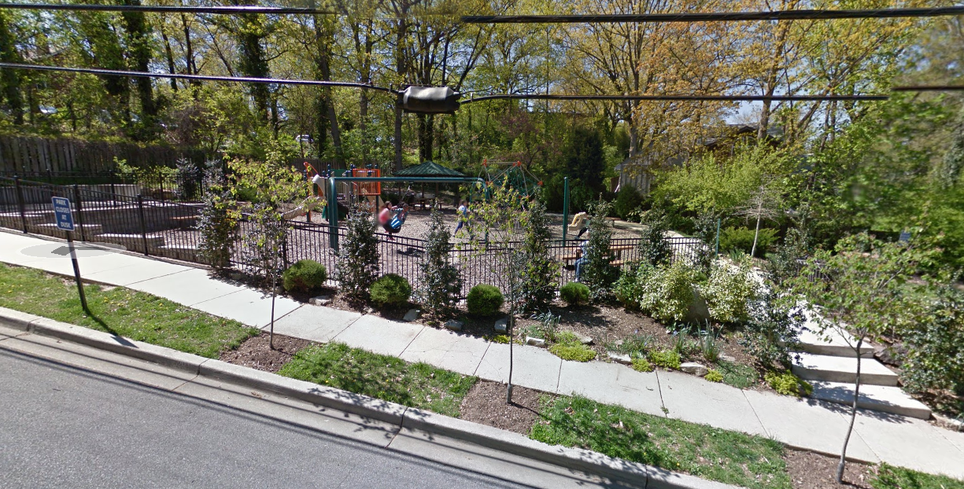
Completed Landscape Project #1

Slide 7
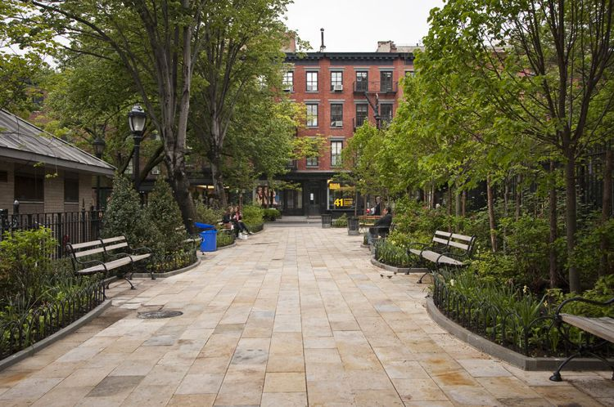
Completed Landscape Project #2

Slide 8
Requirement 2
After completing requirement 1, discuss the following with your merit badge counselor: Tell whether the design had separate spaces, a defined point of entry, a clear path system, and sun and shade variety.
  Discuss how any structures, the designated seating, eating, or parking areas suited the overall design.
  Explain how the design reflected consideration for the comfort, shelter, and security of the users.
  Discuss how the choice of trees, shrubs, and ground covers used in the project contributed to its appeal and function.

Slide 9
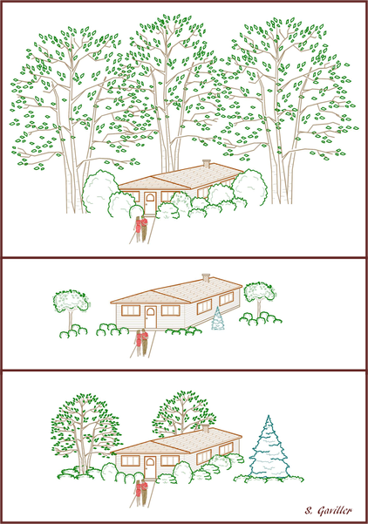
Landscape Architecture Basics
Scale is the relationship of the design to the people who will use it.
Proportion refers to the proper relationship of one part of the composition to another, and to the whole
  The important question is, does that element look correctly placed?
  The top image illustrates a house that is visually overwhelmed by the landscaping – the shrubs next to the house are as tall, or taller than the house, with some even obscuring windows – this scale is too large.
  The middle example is the exact opposite. The trees and shrubs look like toys in comparison to the house – the scale of this landscape is too small.
  The bottom example is what we’re after. The landscape elements are well suited to the size of the house, hence this represents appropriate scale.

Slide 10
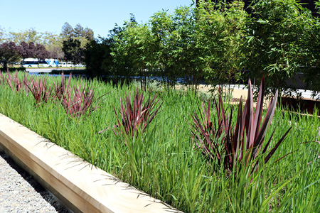
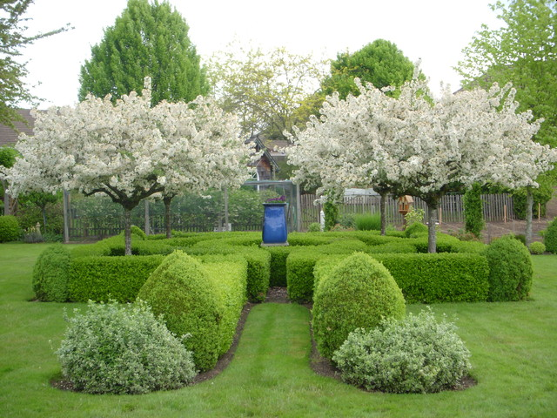
Landscape Architecture Basics
Emphasis, often called accent, is anything in the design that creates a spot of interest.
The effect could be a contrast in color or a contrast in form or texture.

Slide 11
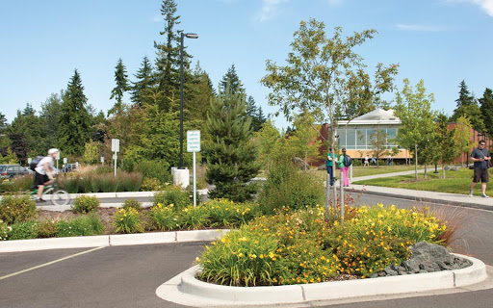
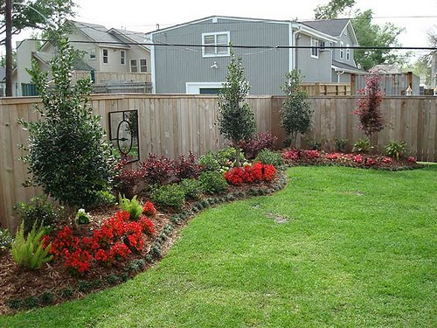
Landscape Architecture Basics
Repetition is the duplication of the same element several times.
Rhythm, often called sequence, breaks the monotony of repetition.
  It changes the routine by introducing, at regular intervals, one or two new elements into the series.
This parking lot shows how flower beds use rhythm to help break up the repetitious monotony of the parking spaces.
This image provides a good example of how varying the plant material creates interest but also repeating the same plant material within the design connects the landscape and visually helps it flow more naturally.

Slide 12
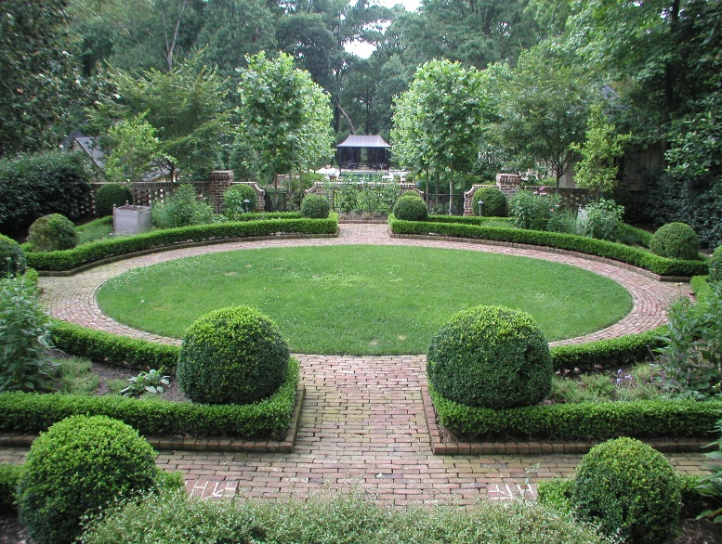
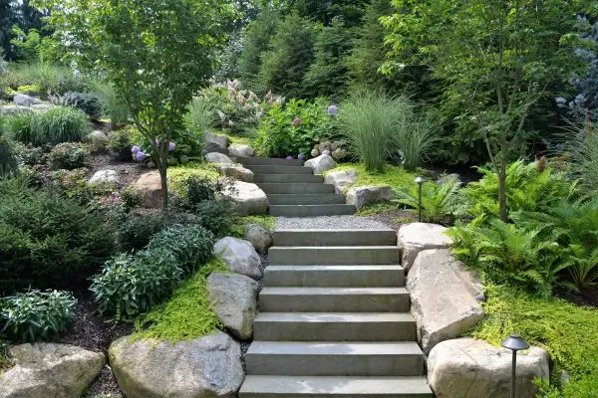
Landscape Architecture Basics
Balance is the visual stability of a composition
  A symmetrical arrangement, with mirrored images on each side of an axis, gives a sense of formality.
  An asymmetrical design, with an irregular yet balanced arrangement of objects, gives a sense of informality.

Slide 13
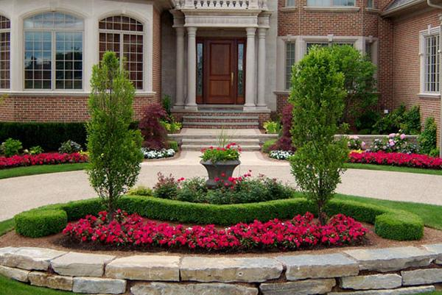
Landscape Architecture Basics
Unity is the quality of being complete – when the separate elements serve the whole and nothing seems out of place or added for decoration.
When all elements come together convincingly, the goal of the overall design has been met.

Slide 14
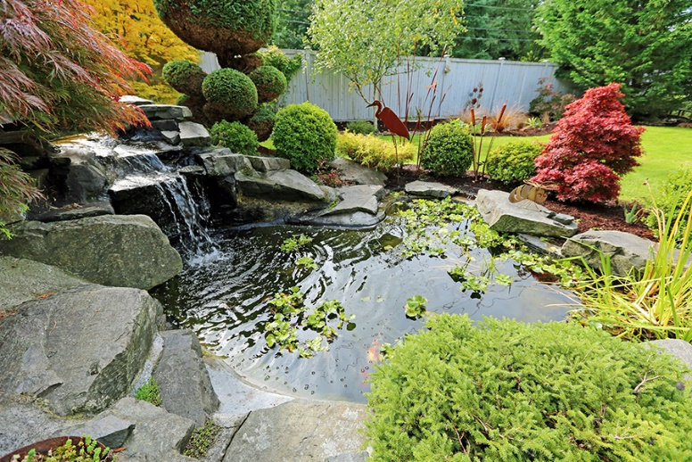
Landscape Architecture Basics
Materials
A landscape design changes daily as the plants and trees grow, flower, and eventually die.
The landscape architect must keep in mind not only what the plants will look like after installation, but also what they will look like at full growth.
The design professional selects trees, shrubs, and ground covers that will thrive in the particular soil, and climatic conditions.
Landscape architects choose plant materials for their unique characteristics and contributions to the design plan.

Slide 15
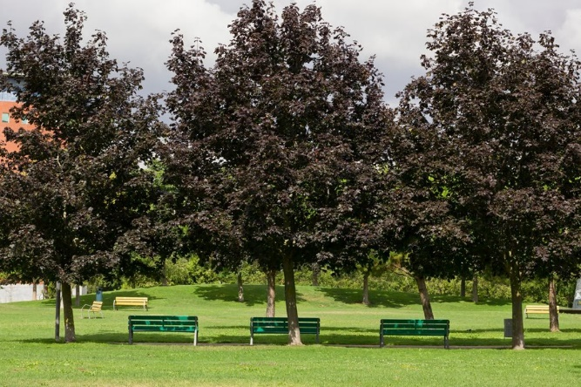
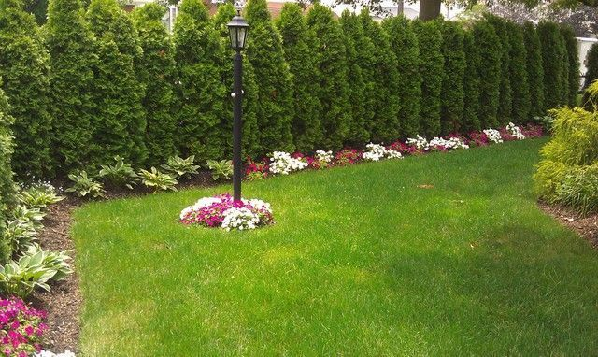
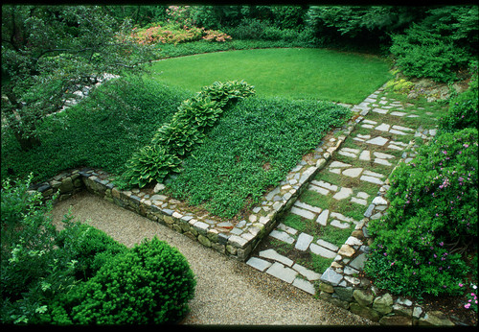
Landscape Architecture Basics
Deciduous trees and shrubs lose their leaves during fall and winter.
  They are important in the landscape because they block the sun’s rays in the summer and allow light through in the winter.
Evergreen trees and shrubs keep their leaves year round.
  They stay green and provide a visual barrier, or screen, in landscape design.
Ground covers are low, wide spreading plants that hug the earth.
  Landscape architects use ground covers where it is too shady for grass to grow well or too steep to mow, or where the color and texture adds more to the design than grass would.

Slide 16
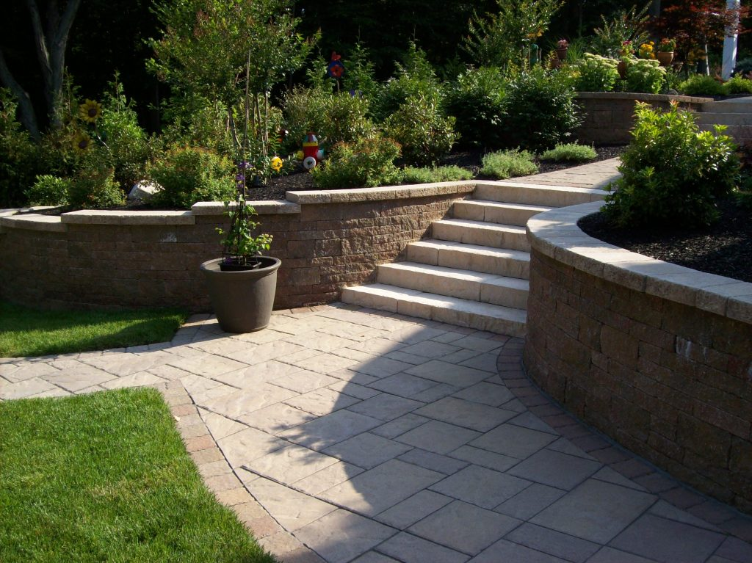
Landscape Architecture Basics
Landscapes also include hard surfaces.
A hardscape is anything that is not soil or plant material.
It includes paved surfaces, steps, walls, fences, terraces, decks, playgrounds, and water features.

Slide 17
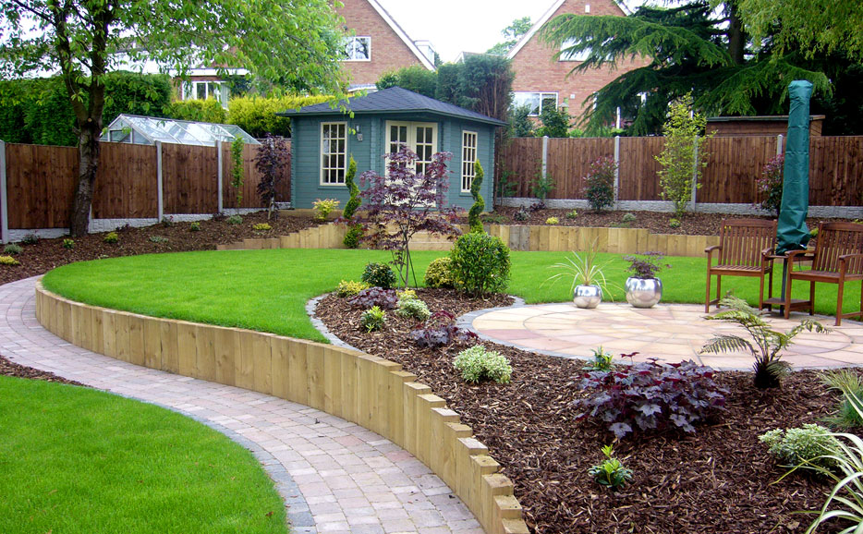
Landscape Architecture Basics
Most plans include both hardscape and landscape materials to give the design structure and distinction, or relief.

Slide 18
Completed Landscape Project #1
Tell whether the design had separate spaces, a defined point of entry, a clear path system, and sun and shade variety.
  Discuss how any structures, the designated seating, eating, or parking areas suited the overall design.
  Explain how the design reflected consideration for the comfort, shelter, and security of the users.
  Discuss how the choice of trees, shrubs, and ground covers used in the project contributed to its appeal and function.

Slide 19
Completed Landscape Project #2
Tell whether the design had separate spaces, a defined point of entry, a clear path system, and sun and shade variety.
  Discuss how any structures, the designated seating, eating, or parking areas suited the overall design.
  Explain how the design reflected consideration for the comfort, shelter, and security of the users.
  Discuss how the choice of trees, shrubs, and ground covers used in the project contributed to its appeal and function.

Slide 20
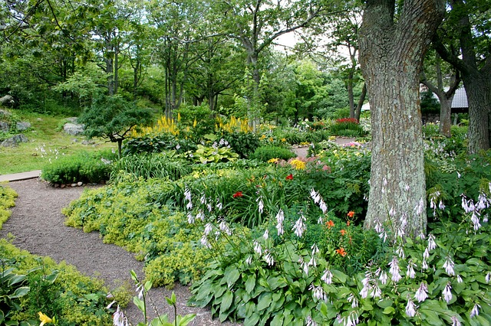
Requirement 3
Identify five shrubs, five trees, and one ground cover, being sure that you select examples of different shapes, sizes, and textures. With the help of your counselor or a local nursery, choose plants that will grow in your area. Bring pictures of the different planting materials or, if possible, examples of their branches, leaves, or flowers to a troop meeting. Be prepared to tell how you might use each in the design of a landscape.
(The following slides provide examples of trees, shrubs, and ground covers that do well in Ohio’s climate. You may choose different examples.)

Slide 21
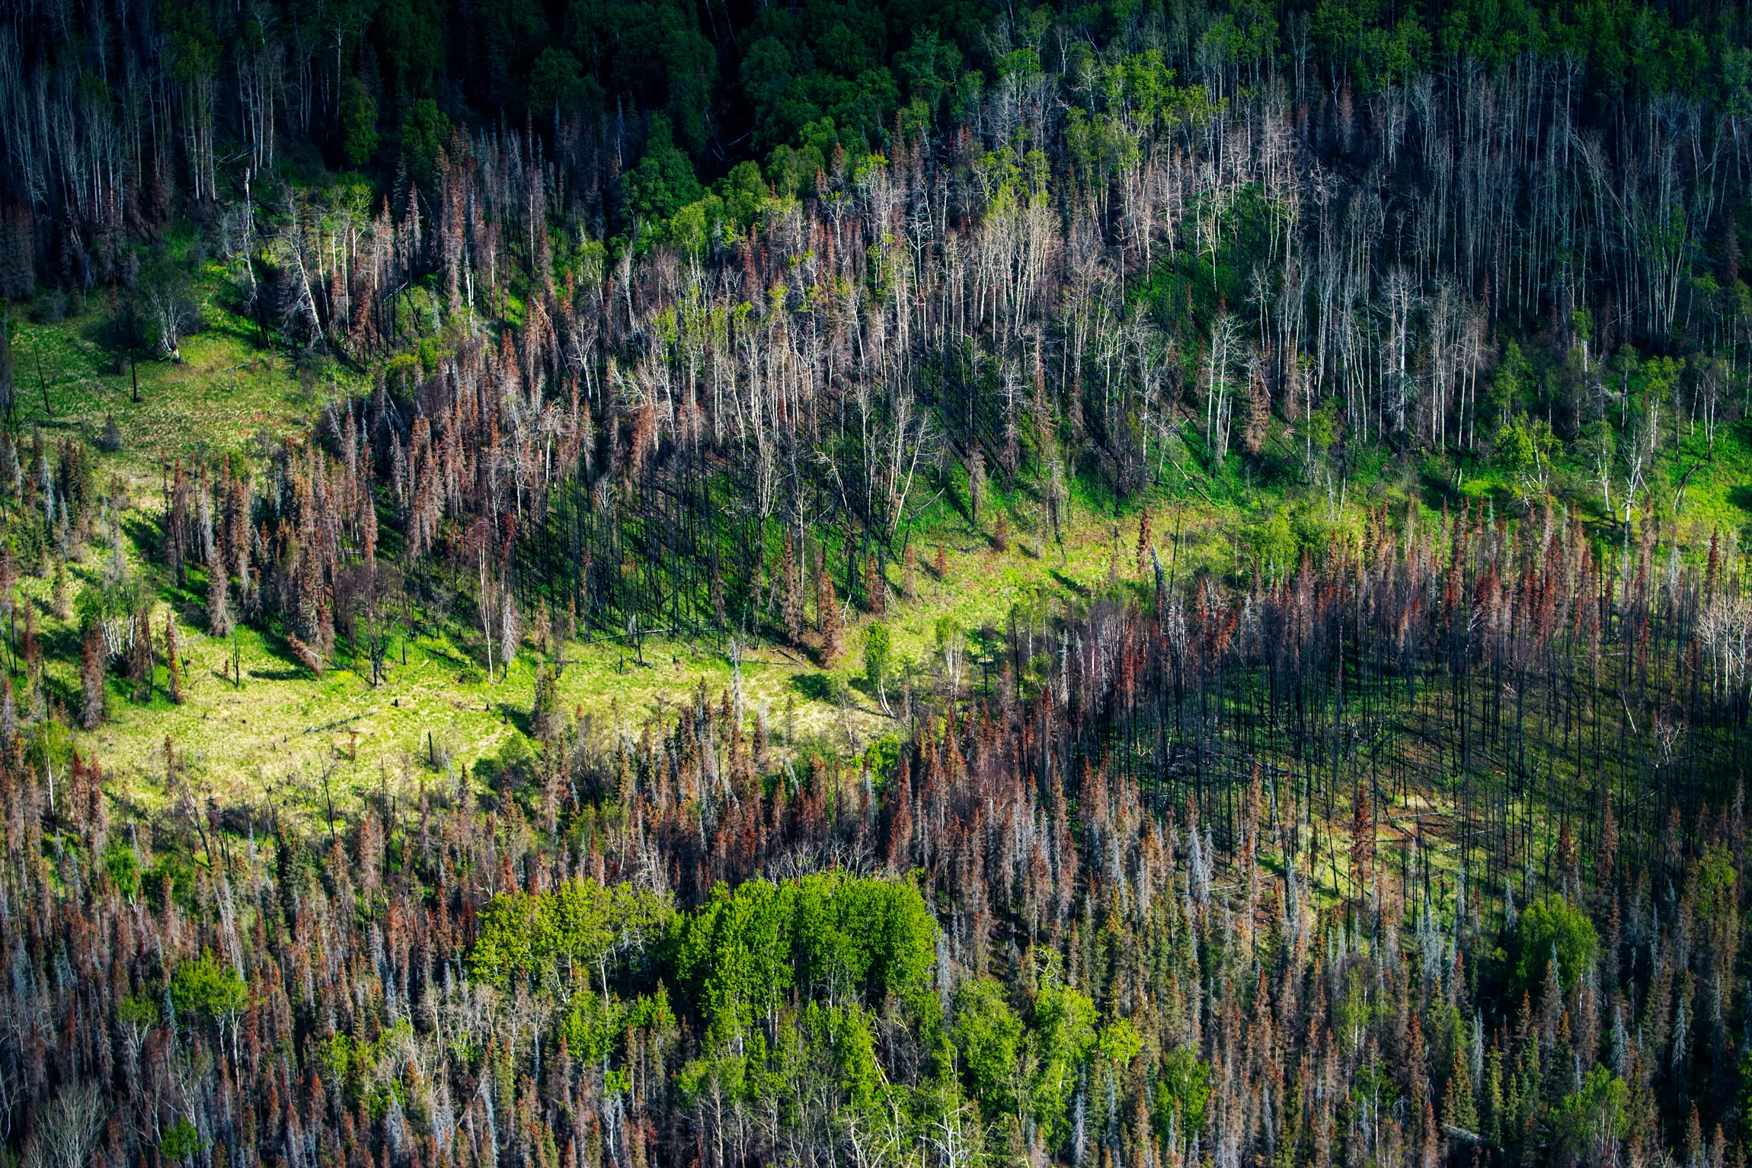
Best Native Trees to Plant
Climate change has already increased temperatures and the frequency of heavy rain events in Ohio.
Over the next several decades, these trends will become more pronounced, altering the forests as we know them.
With this changing climate, some tree species will thrive while others are less likely to survive.
On the next few slides you will find a list of which tree species to plant in these changing conditions, and which ones to avoid.
Loss of trees due to climate change

Slide 22
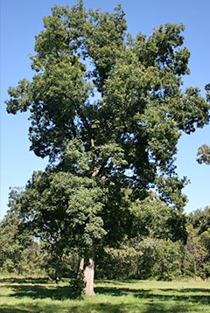
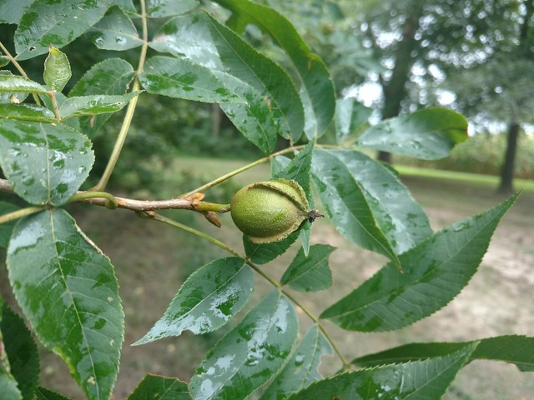
Best Native Trees to Plant
BITTERNUT HICKORY
  Height at maturity 80’ to 100’
  Spread at maturity 60’ to 80’
  Growth per year 18” to 24”

Slide 23
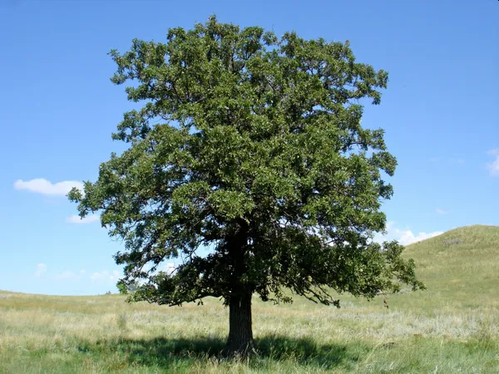
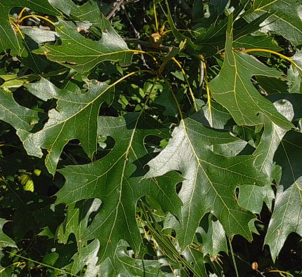
Best Native Trees to Plant
BLACK OAK
  Height at maturity 70’ to 90’
  Spread at maturity 70’ to 90’
  Growth per year 14” to 18”

Slide 24
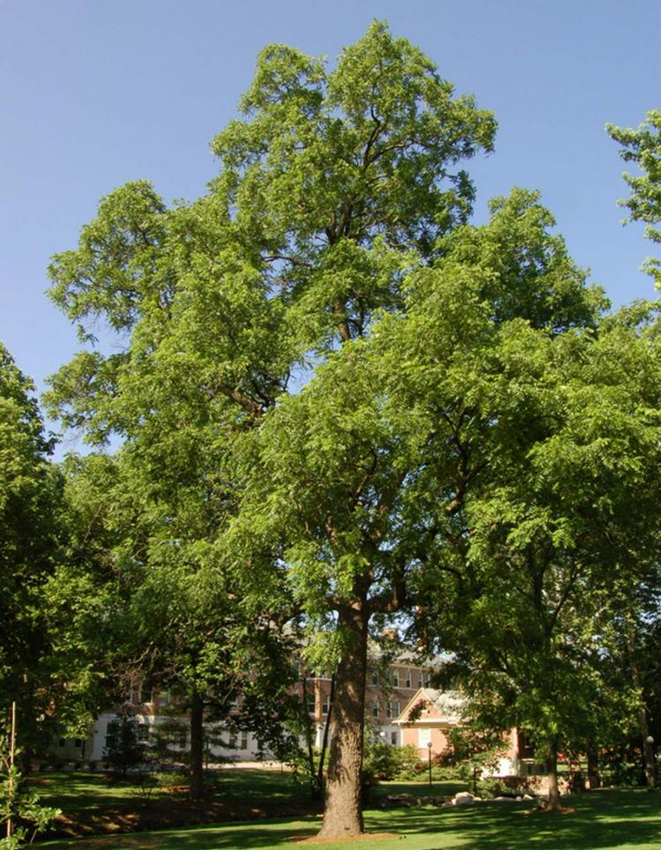
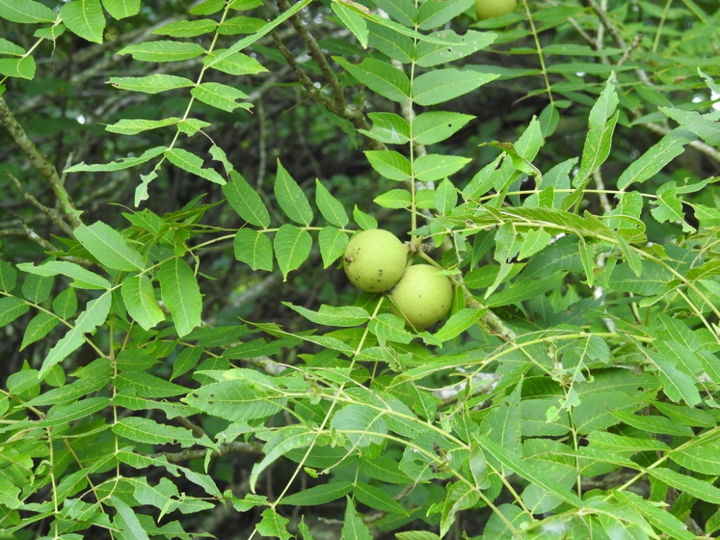
Best Native Trees to Plant
BLACK WALNUT
  Height at maturity 70’ to 90’
  Spread at maturity 70’ to 90’
  Growth per year 18” to 24”

Slide 25
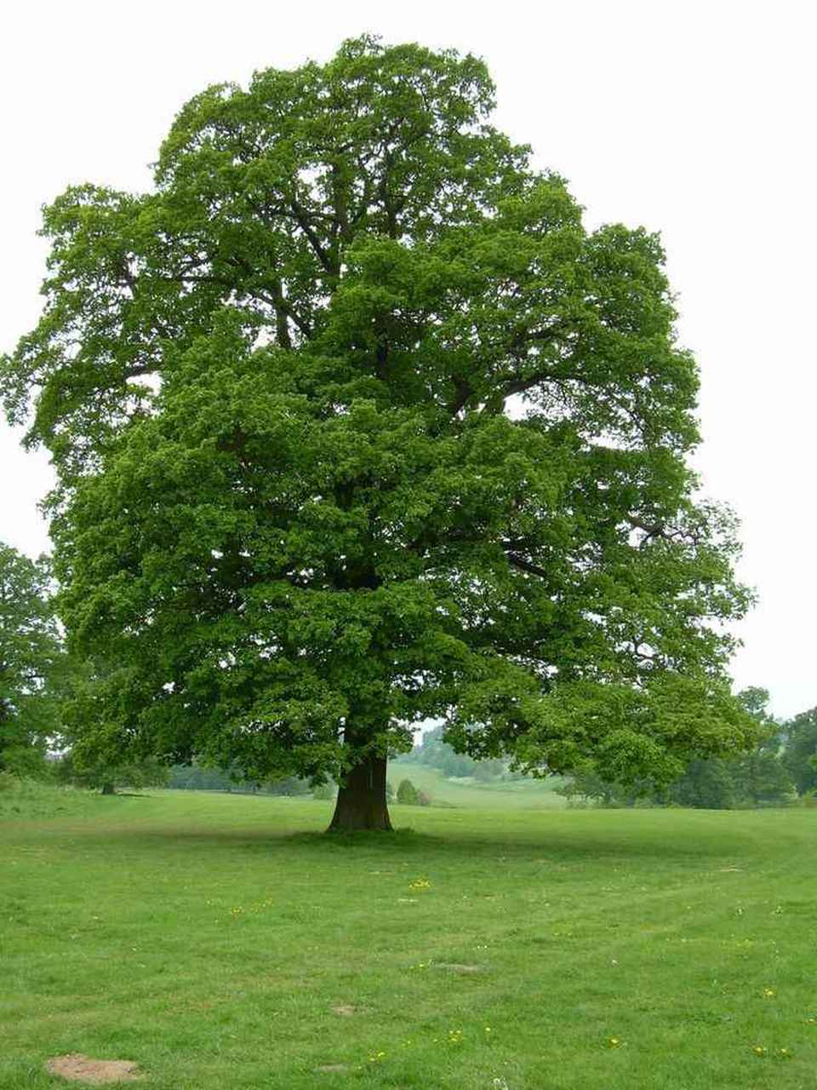
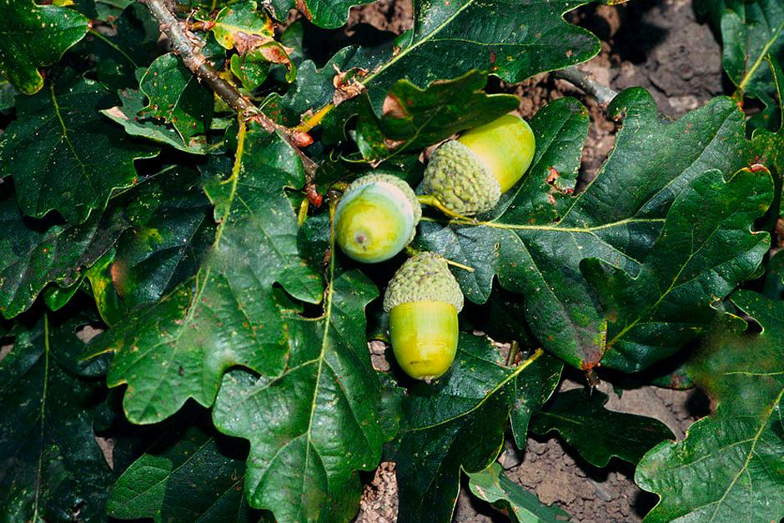
Best Native Trees to Plant
BUR OAK
  Height at maturity 70’ to 80’
  Spread at maturity 70’ to 80’
  Growth per year 14” to 18”

Slide 26
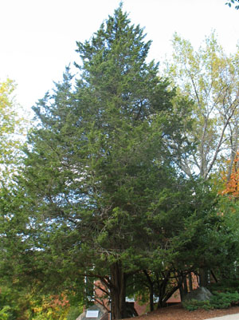
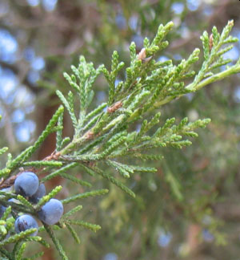
Best Native Trees to Plant
EASTERN REDCEDAR
  Height at maturity 40’ to 55’
  Spread at maturity 10’ to 25’
  Growth per year 9” to 12”

Slide 27
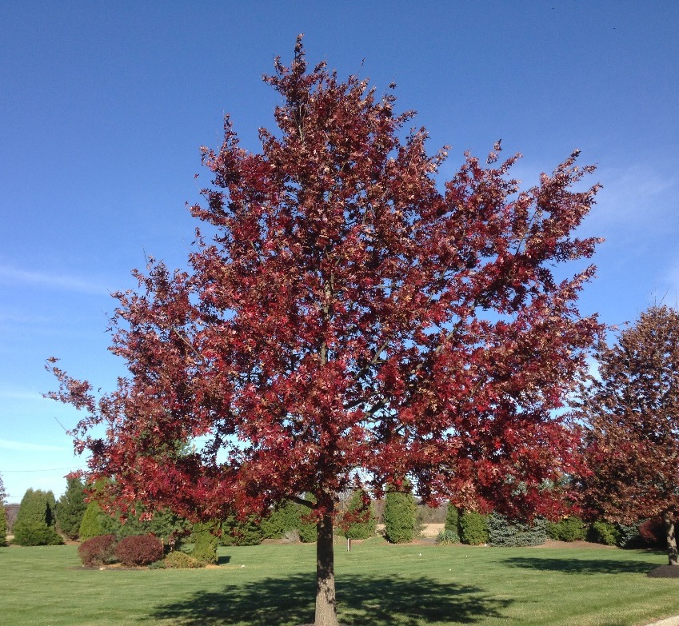
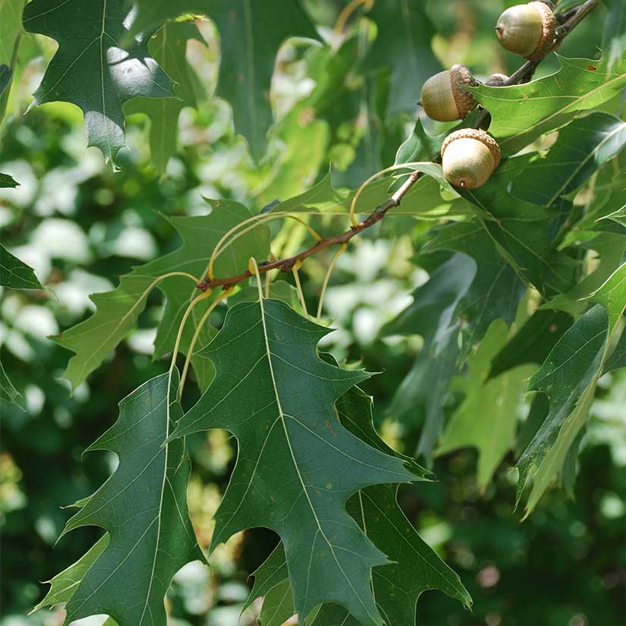
Best Native Trees to Plant
SCARLET OAK
  Height at maturity 70’ to 90’
  Spread at maturity 70’ to 90’
  Growth per year 16” to 20”

Slide 28
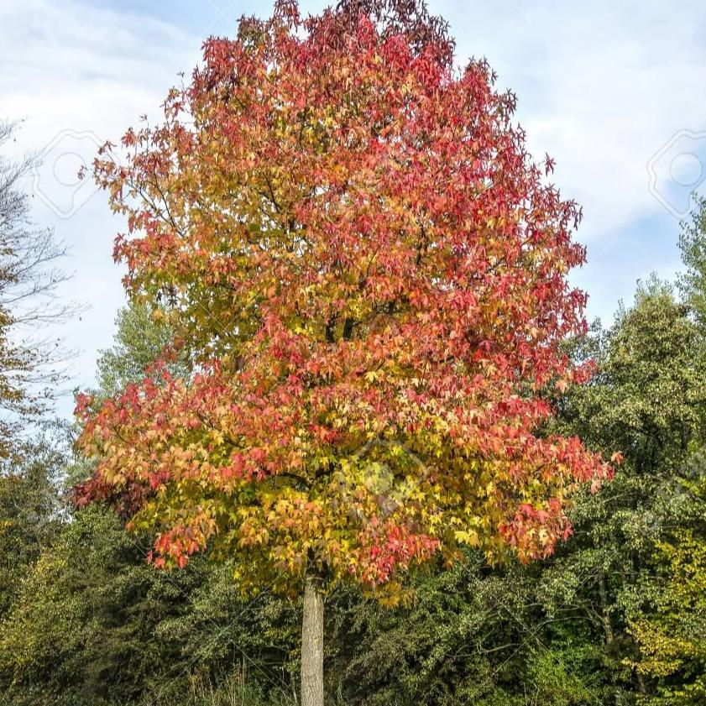
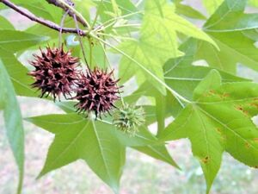
Best Native Trees to Plant
As temperatures rise, Ohio could become a more promising habitat for southern tree species. Climate change models predict the following species should be successful in Ohio in the future:
AMERICAN SWEETGUM
  Height at maturity 60’ to 85’
  Spread at maturity 40’ to 50’
  Growth per year 18” to 24”

Slide 29
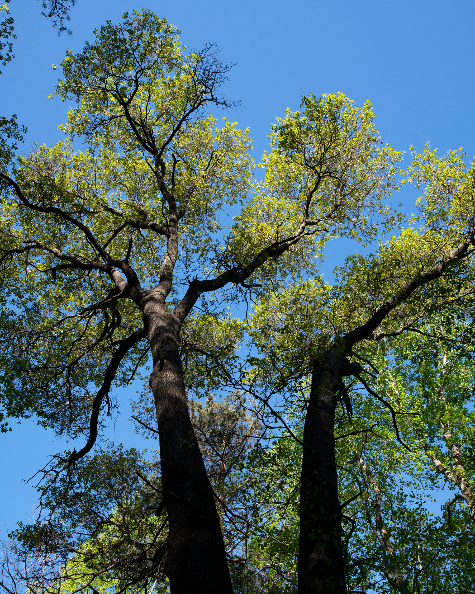
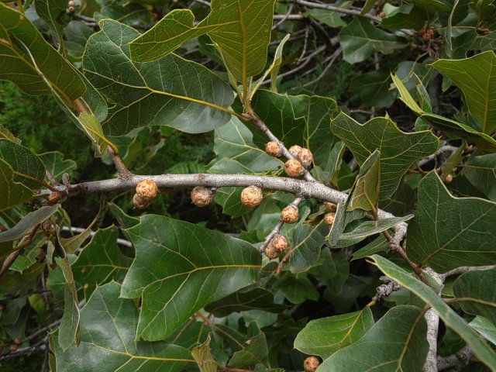
Best Native Trees to Plant
BLACKJACK OAK
  Height at maturity 35’ to 50’
  Spread at maturity 35’ to 60’
  Growth per year 7” to 10”

Slide 30
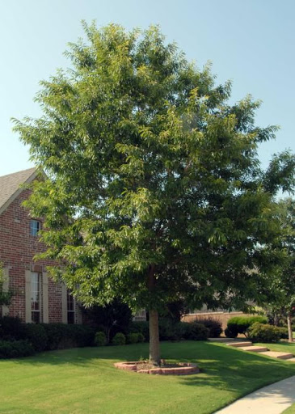
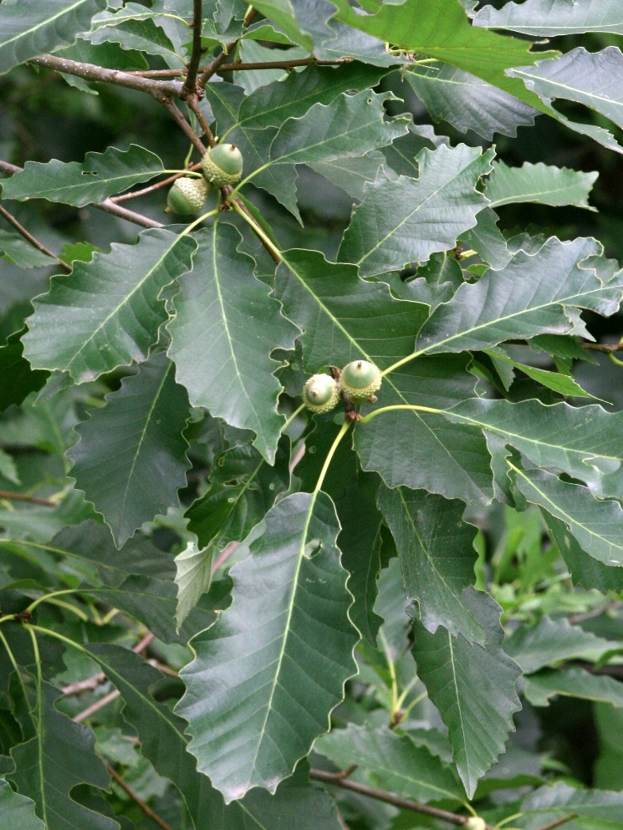
Best Native Trees to Plant
CHINKAPIN OAK
  Height at maturity 70’ to 90’
  Spread at maturity 70’ to 90’
  Growth per year 16” to 20”

Slide 31
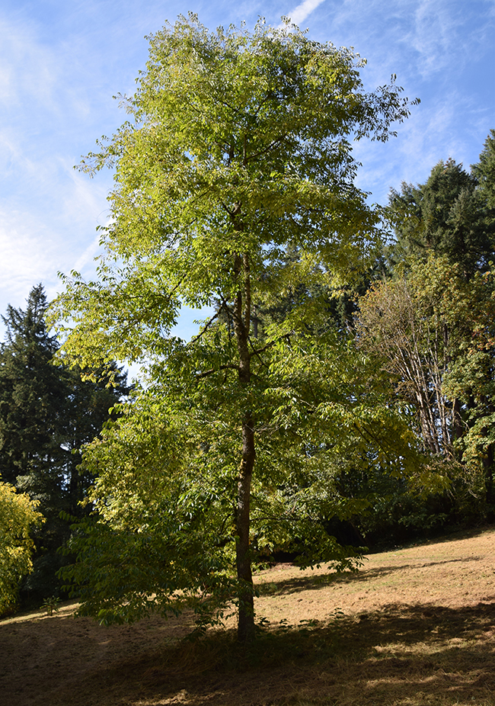
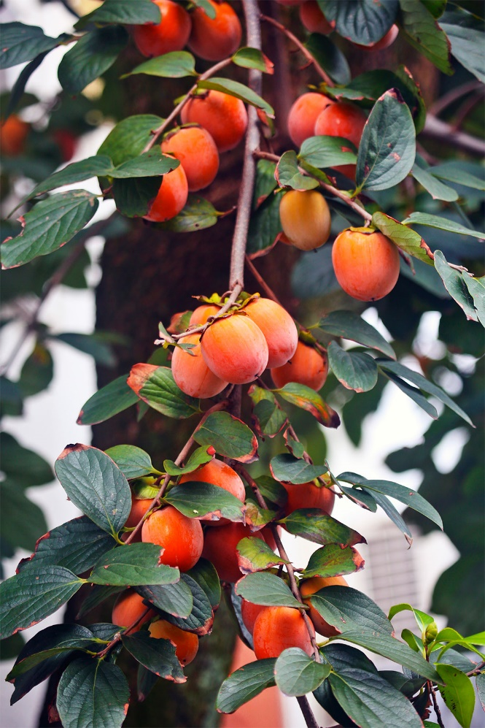
Best Native Trees to Plant
COMMON PERSIMMON
  Height at maturity 45’ to 60’
  Spread at maturity 25’ to 40’
  Growth per year 14” to 18”

Slide 32
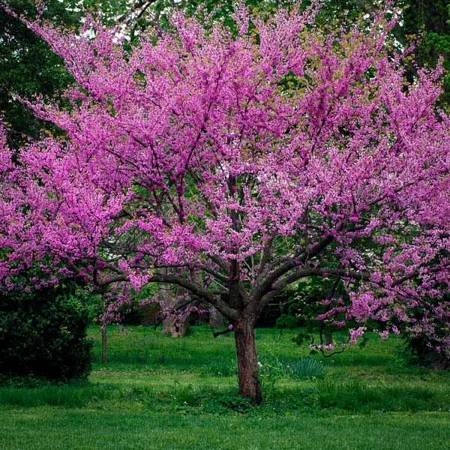
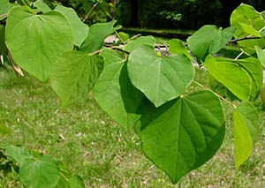
Best Native Trees to Plant
EASTERN REDBUD
  Height at maturity 20’ to 30’
  Spread at maturity 25’ to 35’
  Growth per year 12” to 14”

Slide 33
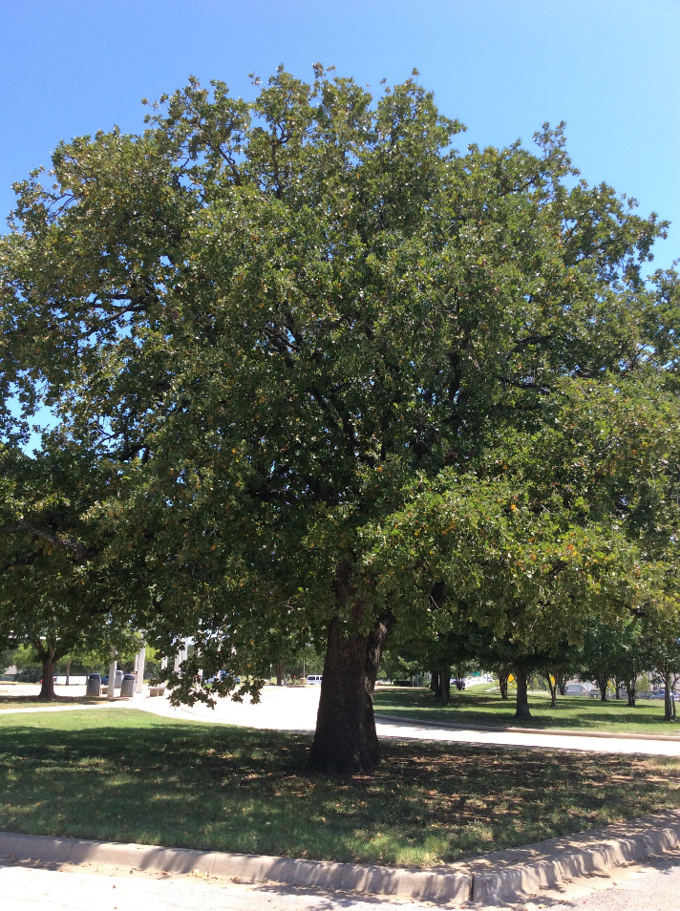
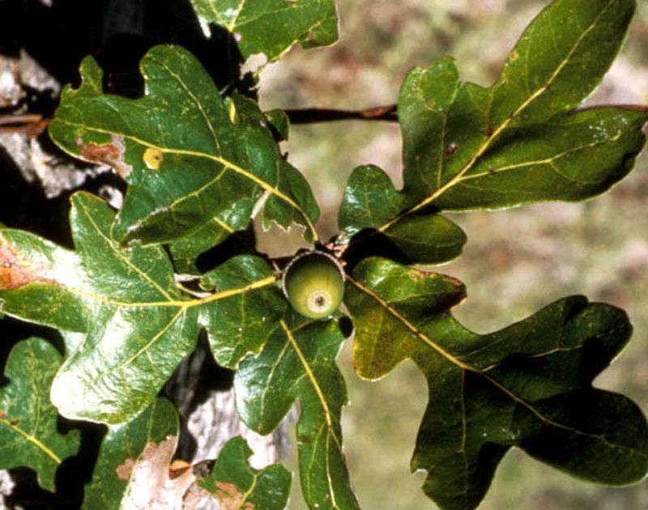
Best Native Trees to Plant
POST OAK
  Height at maturity 40’ to 55’
  Spread at maturity 40’ to 60’
  Growth per year 14” to 18”

Slide 34
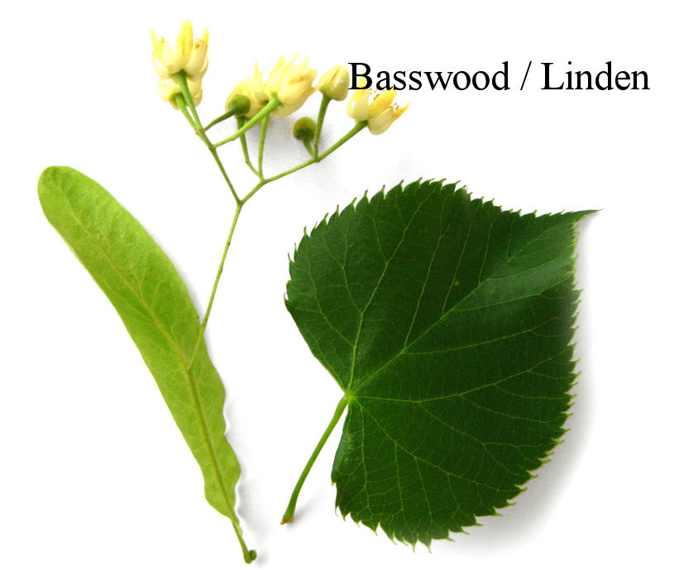
Trees in Trouble
The amount of moisture retained in a forest will likely be affected by rising temperatures and heavier rain events.
Some trees will be less likely to tolerate these moisture changes, making them vulnerable to pests and diseases.
The United States Forest Service (USFS) climate change models project the following species will experience a decline in habitat in Ohio:
  American basswood
  American beech
  American elm
  Bigtooth aspen
  Black cherry
  Black maple
  Eastern hemlock
  Eastern hop hornbeam
  Eastern white pine
  Quaking aspen
  Red maple
  Sugar maple

Slide 35
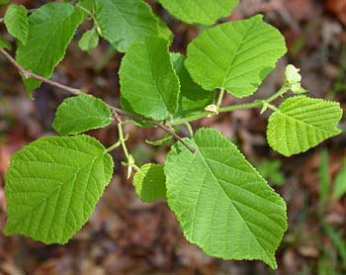
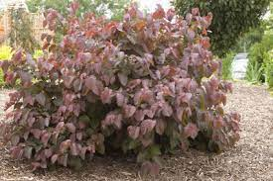
Shrubs
  American Hazelnut (Corylus americana )
  Named for its nutty seedpods, hazels are native to wide geographical regions of the northern hemisphere. The native American hazelnut provides attractive fall color and form to the cultivated garden.
    Sun: Part to Full
    Soil: Loam
    Fertility:
    Moisture: Average
    Height: 10 to 16
    Bloom Time: Mar to Apr
    Bloom Color: Brown to Red
    USDA Zone: 4 to 9

Slide 36
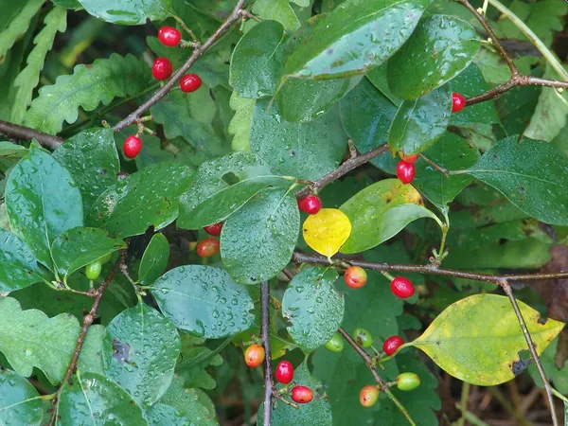
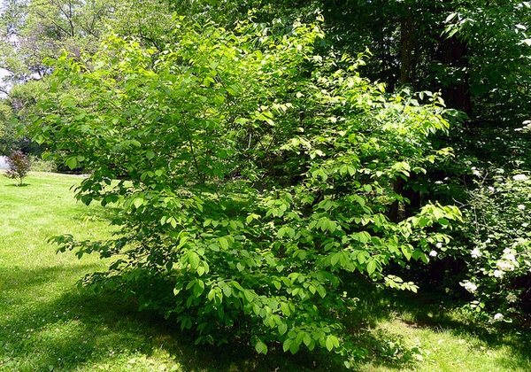
Shrubs
Spice Bush (Lindera benzoin )
  Highly recommended statewide by low maintenance designers, Spicebush is a beautiful shrub for your garden that can tolerate a wide range of sun exposure.
    Sun: Shade to Full
    Soil: Loam to Clay
    Fertility: Average
    Moisture: Average
    Height: 6 to 12
    Bloom Time: Mar
    Bloom Color: Yellow Green
    USDA Zone: 4 to 9

Slide 37
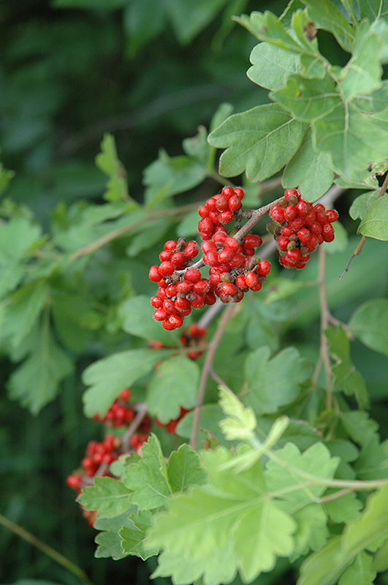
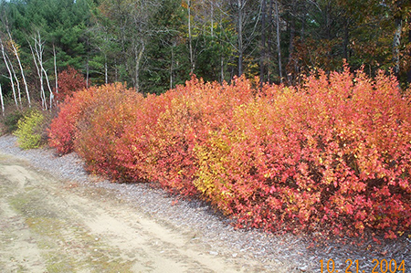
Shrubs
Fragrant Sumac (Rhus aromatica )
  A non-irritating and more attractive shrub relative to poison sumac and poison ivy, this plant provides beautiful spring blooms, summer fruits, and fall color.
    Sun: Part to Full
    Soil: Wide Range
    Fertility: Wide Range
    Moisture: Dry to Average
    Height: 2 to 6
    Bloom Time: April
    Bloom Color: Yellow
    USDA Zone: 3 to 9

Slide 38
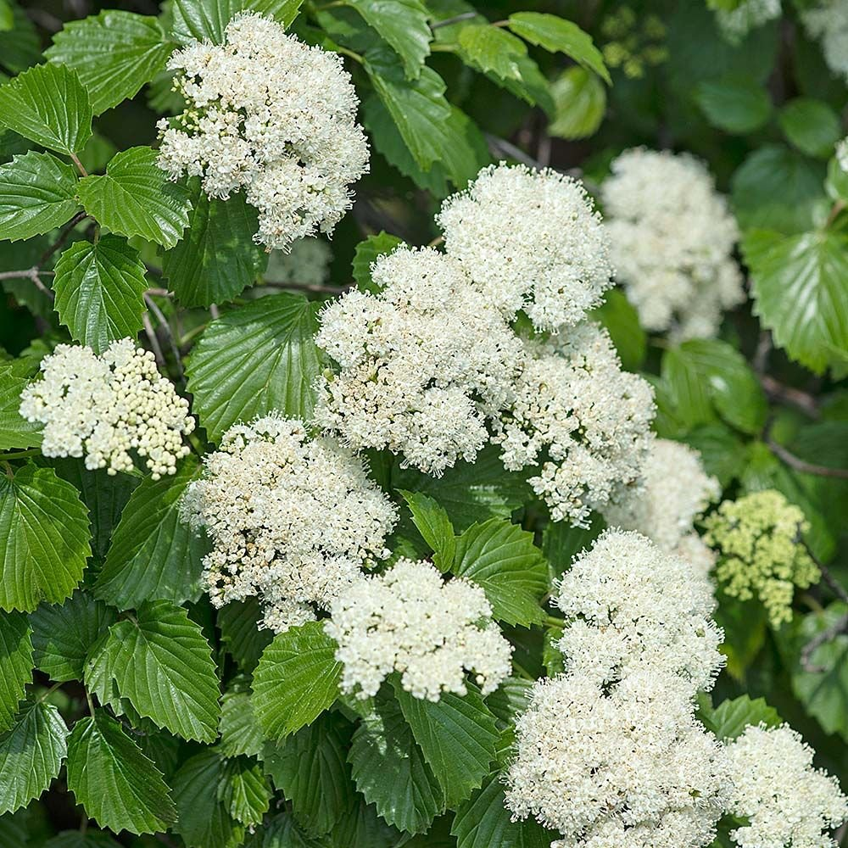

Shrubs
Arrowwood Viburnum (Viburnum dentatum )
  A well-known group of shrubs with puffy summer bloom clusters, there are many native and exotic viburnums. Native viburnums provide excellent adaptation to climate and disease.
    Sun: Part to Full
    Soil: Loam to Clay
    Fertility: Average
    Moisture: Average
    Height: 6 to 10
    Bloom Time: May to Jun
    Bloom Color: White
    USDA Zone: 2 to 8

Slide 39


Shrubs
Virginia Red Cedar (Juniperis virginiana)
  The Juniper genus is widely spread all across the world throughout the northern hemisphere. This evergreen varies from low growing shrubs to medium sized evergreen trees. They provide year-round cover to many native birds and have fine textured foliage to bring year-round interest to your garden.
    Sun: Full
    Soil: Wide Range
    Fertility: Poor to Average
    Moisture: Dry to Saturated
    Height (ft): 30-60
    USDA Zone: 2 to 9

Slide 40


Shrubs
Mission Arborvitae (Thuja occidentalis Techny)
  Arborvitae are common in landscape plantings. These hardy plants are adaptable to many conditions. Specific caution for very windy sites or excessively dry conditions. There are native species of arborvitae that look great in front yard landscaping.
    Sun: Part to Full
    Soil: Loam to Clay
    Fertility: Average
    Moisture: Dry to Moist
    Height: 10 to 15
    USDA Zone: 2 to 8

Slide 41

Ground Cover
Sedums are widely dispersed across the world, with different species from various climates and regions. The following have great low-growing texture and foliage that withstand tough conditions yet provide visual interest.
  Woodland stonecrop (Sedum ternatum )
    Sun: Part to Full
    Soil: Loam
    Fertility: Average
    Moisture: Average
    Height: 25 to 0.5
    Bloom Time: Apr to May
    Bloom Color: White
    USDA Zone: 4 to 8

Slide 42

Ground Cover
  Sedum (Sedum reflexum Angelina)
    Sun: Part to Full
    Soil: Sandy to Loam
    Fertility: Average
    Moisture: Dry to Moist
    Height: 5
    Bloom Time: Jun to Aug
    Bloom Color: Yellow
    USDA Zone: 4 to 9

Slide 43

Ground Cover
CREEPING JUNIPER (Juniperus horizontalis)
  These ground-hugging conifers are prized for their feathery needles, which range in color from blue-green to gold, depending on the cultivar. In winter, color often deepens, providing year-round interest. Sturdy, adaptable, and thrives in tough environments including coastal climates, rocky soils, and dry conditions.
    USDA Zone: 3-9
    Height/spread: 3 to 6 inches tall, spreads 8 to 10 feet
    Special attributes: Tolerates salt exposure, drought, and alkaline soils. Deer resistant.
    Where to use: Trailing over ledges or retaining walls; on slopes.

Slide 44

Ground Cover
JAPANESE PACHYSANDRA (Pachysandra terminalis)
  A lush ground cover for shade, spreads slowly by rhizomes to form a carpet of glossy, emerald-green foliage. Oval leaves are topped by short spikes of white flowers in early spring. Although sweetly scented blooms are short-lived, evergreen foliage remains attractive year-round. Also try Allegheny spurge (Pachysandra procumbens), a native American species with blue-green leaves that turn bronze in fall.
    USDA Zone: 5-9
    Height/spread: 6 to 12 inches tall, spreads 1 to 1-1/2 feet
    Special attributes: Drought tolerant once established; deer and rabbit resistant.
    Where to use: Under shade trees; in woodland gardens; on north-facing slopes. Avoid sunny locations.

Slide 45
Requirement 4
After obtaining permission from the appropriate authority, look at and study a place of worship, school grounds, or a public building and identify where most people arrive by bus or car. Then do the following:
  Using a measuring tape, measure and draw the main site entry and its nearby area. Define the scale of your drawing. Be sure to include the driveway and sidewalk or path that leads to the building’s main entry. Indicate any sidewalks, structures, trees and plants, lights, drains, utilities, or other site furnishings within the study area. Make two copies of this plan and save the original, then do 4b and 4c using the copies.
  On one copy of your site plan, use directional arrows to indicate where the water drains across the site, where ditches occur, and where water stands for a longer period of time.
  Decide how you can make the place safer and more comfortable for those using it. Redesign the area on another copy of the plan. You may want to include new walks, covered waiting areas, benches, space-defining plantings of trees and shrubs, and drainage structures.

Slide 46

Site Plans
Download the Discover Landscape Architecture Activity Book for Teens and Adults to learn how to draw a site plan and solve landscaping issues to prepare you for completing Requirements 4a, 4b, and 4c.
Then complete Requirements 4a, 4b, and 4c using a location that you have chosen.

Slide 47

Requirement 5
Identify three career opportunities that would use skills and knowledge in landscape architecture. Pick one and research the training, education, certification requirements, experience, and expenses associated with entering the field. Research the prospects for employment, starting salary, advancement opportunities and career goals associated with this career. Discuss what you learned with your counselor and whether you might be interested in this career.

Slide 48

Landscape Architect
Description:
  Landscape architects design outdoor spaces, including parks, gardens, urban plazas, and residential areas. They work on sustainable land-use planning, environmental restoration, and aesthetic design.
Education & Training:
  Bachelor's or Master’s degree in Landscape Architecture from an accredited program.
  Courses include site planning, design, environmental science, horticulture, and computer-aided design (CAD).
Certification & Licensing:
  Licensure is required in most states in the U.S. Pass the Landscape Architect Registration Examination (LARE) administered by the Council of Landscape Architectural Registration Boards (CLARB).
  Some states require additional state-specific exams or work experience.

Slide 49

Landscape Architect
Experience & Expenses:
  Entry-level positions may require internships or apprenticeships.
  College tuition varies but typically costs $25,000–$60,000 per year, depending on the school.
  LARE exam fees range from $1,100 to $2,000.
Experience & Expenses:
  Entry-level positions may require internships or apprenticeships.
  College tuition varies but typically costs $25,000–$60,000 per year, depending on the school.
  LARE exam fees range from $1,100 to $2,000.
Job Prospects & Salary:
  Median salary: ~$73,000 per year (U.S. Bureau of Labor Statistics, BLS).
  Job growth projected at 6% from 2022 to 2032.
  Advancement: Senior landscape architect, project manager, or firm owner.
Career Goals:
  Designing sustainable, eco-friendly outdoor spaces.
  Working with urban planning teams to improve city landscapes.
  Specializing in conservation and restoration projects.

Slide 50

Urban Planner
Description:
  Urban planners develop land-use plans to create sustainable and functional communities, addressing zoning laws, transportation, and environmental regulations.
Education & Training:
  Bachelor’s degree in urban planning, geography, landscape architecture, or a related field.
  Master’s degree in Urban Planning (often required for advancement).
Certification & Licensing:
  Certification from the American Institute of Certified Planners (AICP) is beneficial but not required for entry-level jobs.
  Licensing varies by state and job requirements.

Slide 51


Urban Planner
Experience & Expenses:
  Master’s degree programs range from $15,000 to $50,000 per year.
  AICP certification exam fee: ~$425.
  Requires experience in land use, community engagement, and policy-making.
Job Prospects & Salary:
  Median salary: ~$79,000 per year (BLS).
  Projected job growth: 4% from 2022 to 2032.
  Advancement: Senior planner, department head, or consultant.
Career Goals:
  Improving urban infrastructure and public spaces.
  Designing communities with efficient transportation and green spaces.
  Working in government agencies or private consulting firms.

Slide 52

Golf Course Designer
Description:
  Golf course designers create functional and visually appealing golf courses by blending natural landscapes with strategic course design. They work closely with engineers, landscapers, and environmental specialists.
Education & Training:
  Bachelor’s degree in landscape architecture, turfgrass management, or golf course design.
  Some designers learn through apprenticeships with experienced golf course architects.
Certification & Licensing:
  No mandatory licensing, but membership in the American Society of Golf Course Architects (ASGCA) can enhance credibility.

Slide 53

Golf Course Designer
Experience & Expenses:
  Gaining experience in landscape architecture or turf management is essential.
  Tuition costs: ~$20,000–$50,000 per year.
  CAD and GIS software training may be required.
Job Prospects & Salary:
  Median salary: ~$65,000–$120,000 per year (depends on experience and projects).
  Competitive field, but opportunities exist in resort development and golf course renovations.
  Advancement: Lead designer, project manager, or independent consultant.
Career Goals:
  Creating environmentally sustainable golf courses.
  Blending aesthetic appeal with playability.
  Working on international golf course projects.

Slide 54

Landscape Contractor
Description:
  Landscape contractors plan, build, and maintain outdoor spaces for residential, commercial, and public properties. They work on projects such as gardens, patios, irrigation systems, retaining walls, and park landscapes.
Education & Training:
  No formal degree is required, but a background in landscape architecture, horticulture, or construction management is beneficial.
  Associate’s or Bachelor’s degree in landscape management, horticulture, or a related field can enhance job opportunities.
  Hands-on experience through apprenticeships, internships, or working for established landscaping businesses is crucial.
Certification & Licensing:
  Many states require a landscaping contractor’s license, which involves passing an exam and fulfilling experience requirements.
  Certifications like Certified Landscape Technician (CLT) or Certified Irrigation Contractor (CIC) can improve credibility.
  OSHA safety certification is often required for construction projects.

Slide 55

Landscape Contractor
Experience & Expenses:
  Experience in landscaping, gardening, or construction is valuable.
  Licensing fees range from $100 to $500, depending on the state.
  Startup costs for independent contractors (tools, equipment, insurance) can be $10,000 or more.
Job Prospects & Salary:
  Median salary: ~$45,000–$80,000 per year, with potential to earn six figures as a business owner.
  Job growth is steady, driven by demand for landscaping services in residential and commercial properties.
  Advancement: Start an independent landscaping business, move into landscape design, or specialize in high-end projects.
Career Goals:
  Running a successful landscaping business.
  Creating sustainable outdoor environments.
  Specializing in areas like irrigation systems, hardscaping, or ecological restoration.

